Slide 1
Capstone project Battle of indian cities
Exploration of various venues of Indian Cities

Slide 2
Introduction
India is the 2nd most populous country in the world. It is also 5th largest economy and also vibrant hub for entrepreneurship activity.
It is diverse, multicultural and provides a secure, safe and comfortable business environment.
But unfortunately the data available about different cities is minimal.
So, data about various places needs to be created for businesses, citizens, government etc to make better decisions.

Slide 3
Business Problem
Parsing the data available about Indian cities and presenting it in a more understandable format along with clustering cities based on number of popular places
Many applications including establishment of businesses, selecting relocation cities etc

Slide 4
Target Audience
Businesses/ Investors/ Entrepreneurs: Decision upon where to start a new business like restaurant across India. What business is missing in which city?
Citizens: Decide upon relocation based on his preferences for food, museums, entertainment, shopping etc
Travelers: Decisions about tourism plans becomes easier with detailed sorting of information about destination, ccultural places, food availability etc
Government: Policy decisions about incentives to businesses, tourism promotion etc can be made

Slide 5
Data Sources
Location of various cities across India along with latitude and longitudes is needed. Data(CSV) file from https://simplemaps.com/data/in-cities is used for this. This CSV file is read in the project and converted to a data frame. Here is a sample of CSV
Venue data of various Indian cities is extracted using Foursquare Explore venue API. It returns a list of different kind of venues like Hotels, Restaurants, Museums etc. More details can be explored in https://developer.foursquare.com/docs/api. Below is a data frame constructed with this data.

Slide 6
Methodology involved
Information about various Indian cities like latitude and longitude is extracted from the CSV file mentioned in data section above.
Then we will use the Foursquare API to explore neighborhoods in these cities and create data frame about various venues
Group data about venues based on Venue Categories per city
Use KMeans cluster for clustering of various Indian cities.
Map these cities using Folium library
For city in each cluster, find information about most occurring venues and store it in a dataframe.
General Waffle Charts for better representation of number of cities in each cluster to get a comprehensive overview.

Slide 7
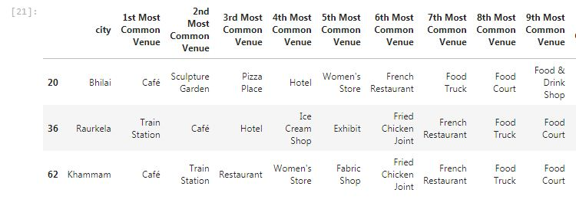
Results
The information about most common places and clustering of cities will be very helpful for various stakeholders like businesses, citizens, government etc

Slide 8
Discussion
A look at the most common venues shows the richness of Indian cities
It shows many results
For instance, Government can evaluate the effectiveness of their financial inclusion programmes as ATMs formed the most common in cluster 3.
Tourists can diversify their choices like Cluster 5 provides different experiences including Sculpture garden
Many Indian cities are dominated by hotels, restaurants etc. So, there is no dearth of cuisines

Slide 9
Conclusion
Although all of the goals of this project were met there is definitely room for further improvement and development as noted above. Addition of further data related to transportation, crimes, education, hospitals etc can create an overall data base. Through the analysis, let us hope that it will be used in future for better policy decisions, business establishment, tourist arrivals to India etc.

